Slide 1

Digits n Data SQL Challenge ‘Stranger Things’ Database Analysis

Slide 2

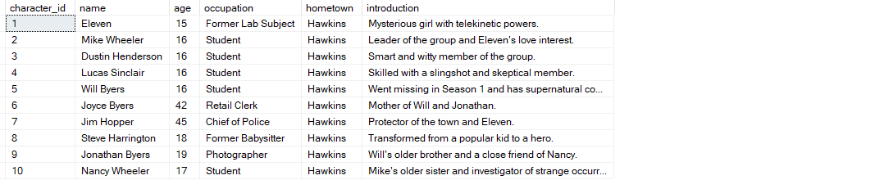
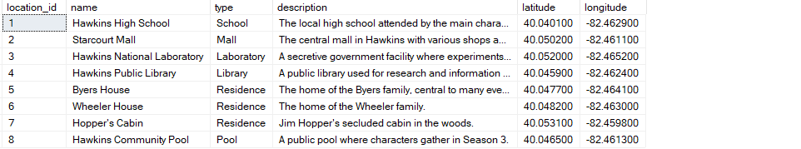
Retrieving all the data:
select * from Characters
select * from Locations

Slide 3
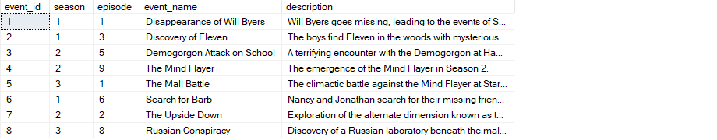
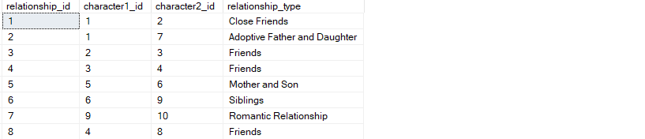
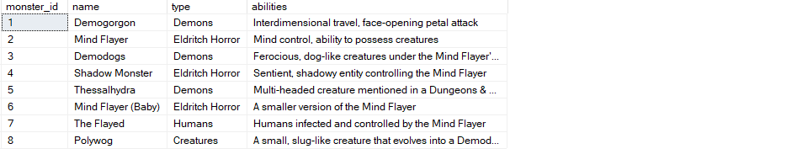
select * from Events
select * from Relationships
select * from Monsters

Slide 4
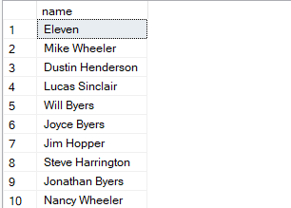
1. Retrieve the names of the characters?
SELECT name FROM Characters;

Slide 5

2. Find characters with age greater than 18?
SELECT character_id ,name ,age
FROM Characters
WHERE age > 18;

Slide 6
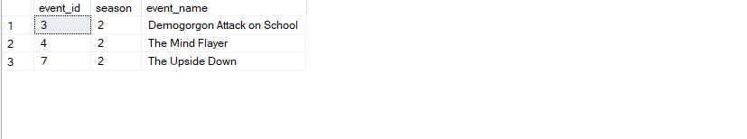
3. Find events in Season 2?
SELECT event_id ,season ,event_name
FROM Events
WHERE season = 2;

Slide 7
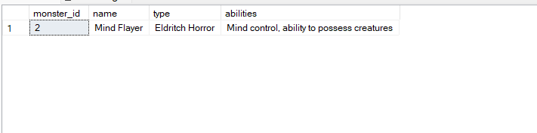
4. Get details of the 'Mind Flayer' monster?
SELECT * FROM Monsters
WHERE name = 'Mind Flayer'

Slide 8
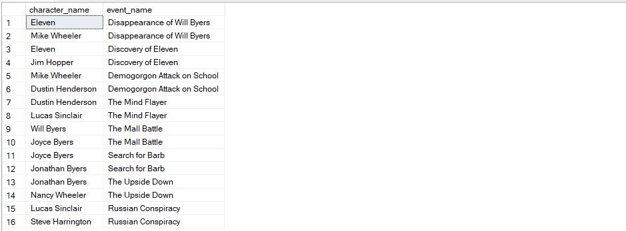
5. Retrieve characters and their associated events?
SELECT c.name AS character_name ,e.event_name
FROM Characters c
JOIN Relationships r
ON c.character_id = r.character1_id OR
c.character_id = r.character2_id
JOIN Events e
ON r.relationship_id = e.event_id;

Slide 9
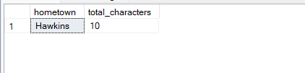
6. Calculate the total number of characters from each hometown?
SELECT hometown , count(*) AS total_characters FROM Characters
GROUP BY hometown

Slide 10
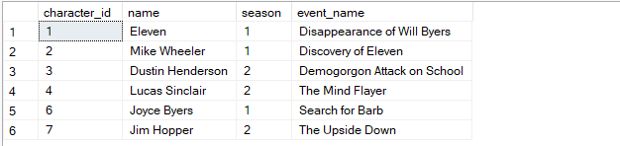
7. Retrieve characters who were involved in events in Season 1 or Season 2?
SELECT c.character_id, c.name, e.season, e.event_name
FROM
Characters c
JOIN
Events e ON c.character_id = e.event_id
WHERE e.season IN ( 1 ,2 );

Slide 11
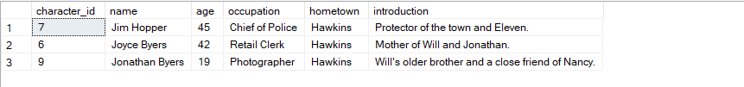
8. Find the top 3 oldest characters?
SELECT TOP 3 *
FROM Characters
ORDER BY age DESC

Slide 12

9. Find the average age of characters in Hawkins?
SELECT AVG(age) AS average_age
FROM Characters
WHERE hometown = 'Hawkins'

Slide 13
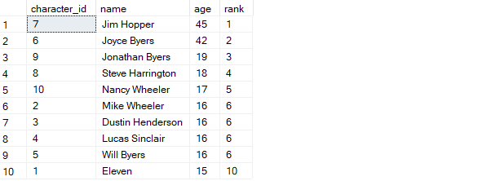
10. Rank characters by age in descending order?
SELECT character_id ,name ,age,
RANK() OVER (ORDER BY age DESC) AS rank
FROM Characters

Slide 14
Thank You

